Slide 1

Welcome to the FC2 Female Condom Training Workshop
By the female health company

Slide 2
Learning objectives
FC2 Female Condom Training
At the end of the workshop it would be expected that participants:
Can discuss, demonstrate and promote FC2 with competence and confidence.
Have knowledge about how the FC2 female condom is used to prevent unintended pregnancies and sexually transmitted infections (STIs), including HIV.
Can demonstrate proper insertion and use of FC2.
Can provide accurate information on FC2 use.
Have developed a positive attitude about FC2.

Slide 3
Workshop activities (1)
Module 1: Workshop overview and getting to know you.
Welcome.
Ground rules.
Get to know you.
What do I really think?
Module 2: Overview of HIV epidemic and sexual reproductive health.
Introduction to prevention methods that provide double protection.

Slide 4
Workshop activities (2)
Module 3: FC2 Why? What? How?
Introduction to FC2 female condom.
Female anatomy and FC2.
The use of FC2.
Insertion practice.
Potential failure problems and how to fix them.
Module 4: Talking with clients.
Promotional messages.
Education skills.

Slide 5
Learning objectives Module 1
Overview and getting to know you
By the end of this module participants will be able to:
Describe the objective for the workshop.
Explore personal notions, feelings, values regarding the female condom.
Describe how these notions, feelings and values can affect the promotion of FC2.

Slide 6
Learning objectives Module 2
Overview of HIV and SRH
By the end of this module participants will be able to:
Summarize national and/or local STI, HIV and unintended pregnancy statistics.

Slide 7
Learning objectives Module 3
FC2 Why? What? How?
By the end of this module participants will be able to:
List who can use FC2.
List the benefits of FC2.
Describe important female anatomy and physiology as it relates to the insertion of FC2.
Explain and demonstrate the use of FC2.

Slide 8
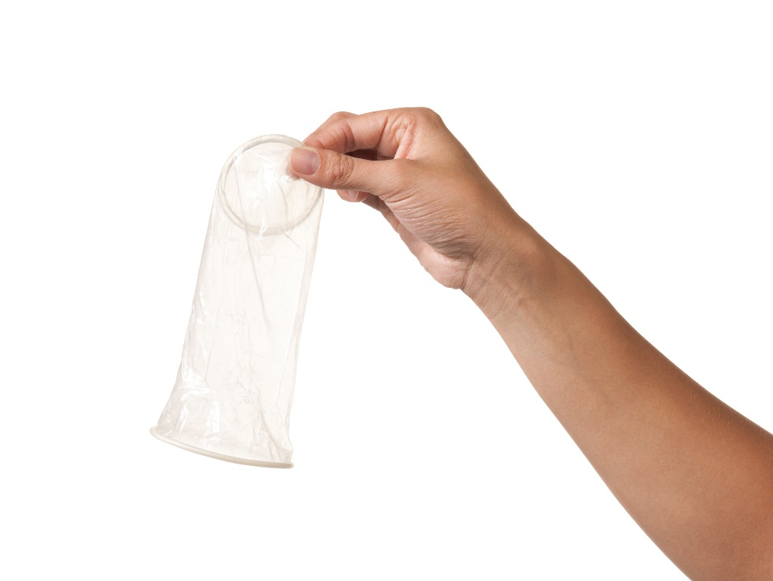
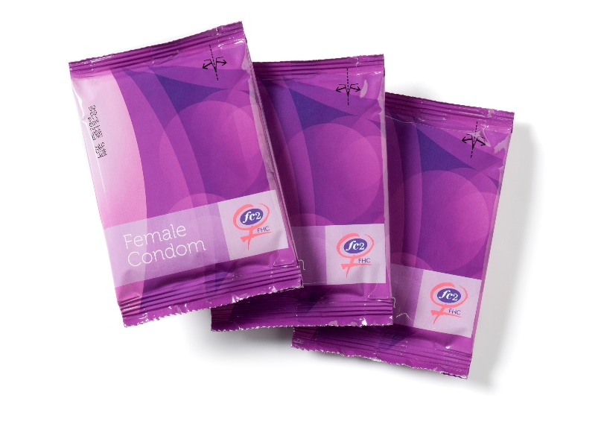
FC2 – The look

Slide 9
What is FC2 female condom?
FC2 is a strong, soft, nitrile sheath or pouch of 17 cm (6.5 inches- the same size as the male condom) in length. Nitrile polymer (non-latex), is thin and strong and warms up to body temperature.
FC2 can be inserted prior to sex since it is worn by the woman and the man doesn’t need to be erect.
FC2 cannot be used simultaneously with a male condom.
FC2 contains a silicone-based lubricant on the inside of the condom, but additional lubrication can be used for extra pleasure. FC2 does not contain spermicide.

Slide 10
How FC2 works (1)
FC2 has a flexible ring at the closed end of the pouch with a slightly larger ring at the open end.
At the closed end of the sheath, the flexible ring is inserted into the vagina to keep the female condom in place.
At the open end of the sheath, the ring stays outside the vulva at the entrance of the vagina.

Slide 11
How FC2 works (2)
The outer ring:
Acts as a guide during penis penetration.
Prevents the sheath from bunching up inside the vagina.
Covers the genitalia and base of the penis and adds extra protection against transmission of STIs

Slide 12
Why FC2 is important?
Female condoms work to prevent pregnancy and STIs, including HIV, by lining the inside of the vagina, preventing skin touching skin.
They collect pre-cum and semen when a man ejaculates, keeping sperm from entering the vagina and thereby preventing pregnancy and reducing the risk of STIs.
Women have options available to them to increase protected sex acts and decrease the transmission of STIs and unintended pregnancy. Providers play an important role in presenting all the options of protection to their clients.

Slide 13
Who can use FC2?
All women and men who want to prevent unintended pregnancies and protect themselves against STIs, including HIV.
Women/men who don’t want to use the male condom.
People who are allergic/sensitive to latex.
People who are HIV positive.
Women who are menstruating.
Women who have recently given birth.
Women who have a retroverted uterus.
Women who have had a hysterectomy.
Women who are (peri and post) menopausal.

Slide 14
Advantages of FC2 (1)
Prevents pregnancy, STIs and HIV infection.
Provides pleasure for both men and women (double pleasure rings).
Female and male can initiate use.
Facilitates communication, instills confidence and assertiveness in women.
Provides another option for women and men.
Lubrication makes sex more pleasurable for (peri and post) menopausal women.

Slide 15
Advantages of FC2 (2)
Can be inserted in advance and does not require immediate removal.
Option for women and men who are allergic to latex.
Can be used during menstruation.
Covers external genitalia partially in women, giving a wider protection area.
A woman can urinate with the condom in the vagina.

Slide 16
How effective is FC2?
Over 17 years of study have shown the female condom is an effective barrier against many common STIs, including HIV.
It is estimated that correct and consistent use of the female condom for one year with an HIV+ partner could reduce a woman’s risk of acquiring HIV by 90%.
Studies in the U.S. and internationally have found that the prevalence of STIs decline and the rate of protected sex acts increase when female condoms are made available alongside the male condom.

Slide 17
FC2 Regulatory approvals
In March 2009, FC2 was approved for market by the United States Food and Drug Administration (USFDA). FC2 is the only female condom that is FDA approved for market.
In 2006, WHO judged FC2 to be acceptable for purchase by UN agencies.
In 2005, FC2 received the CE mark in Europe.
Registration in approximately 120 countries.

Slide 18
Concerns about FC2
Will it hurt during sex?
Will it get lost in me?
Will I be able to get it out?
Isn’t it too big for my vagina?
Won’t the outside ring hurt?
Is it too small for my partner’s penis?

Slide 19
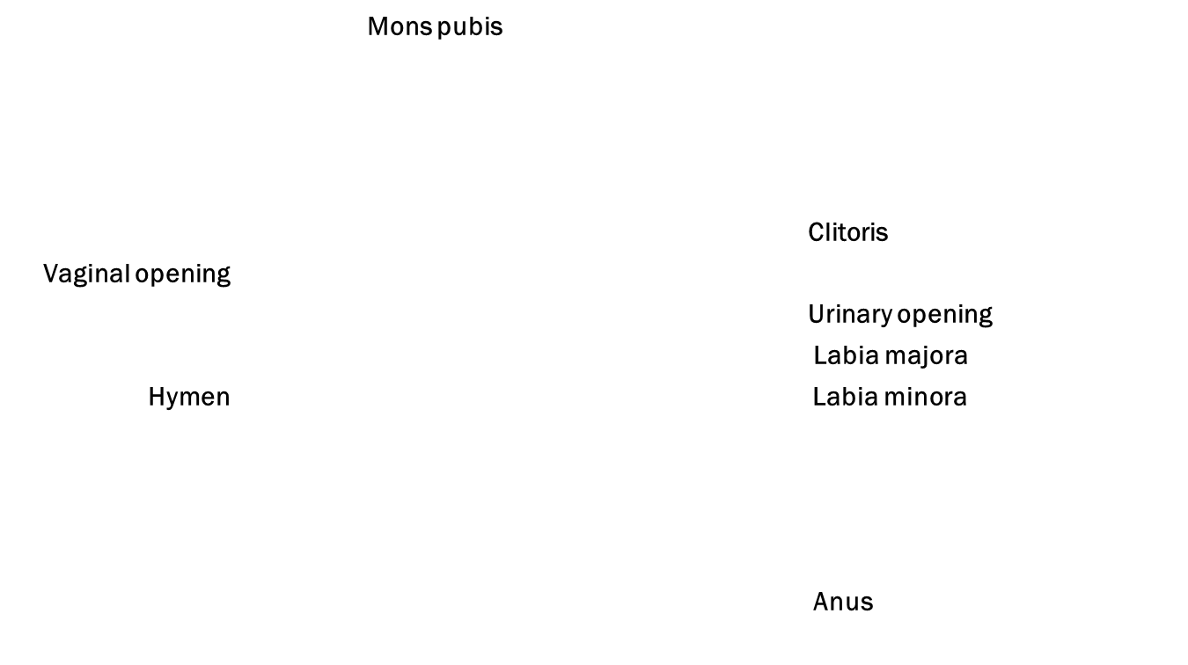
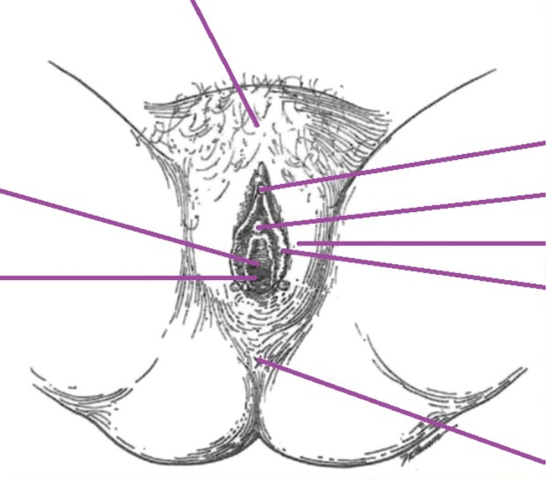
External female reproductive organs

Slide 20
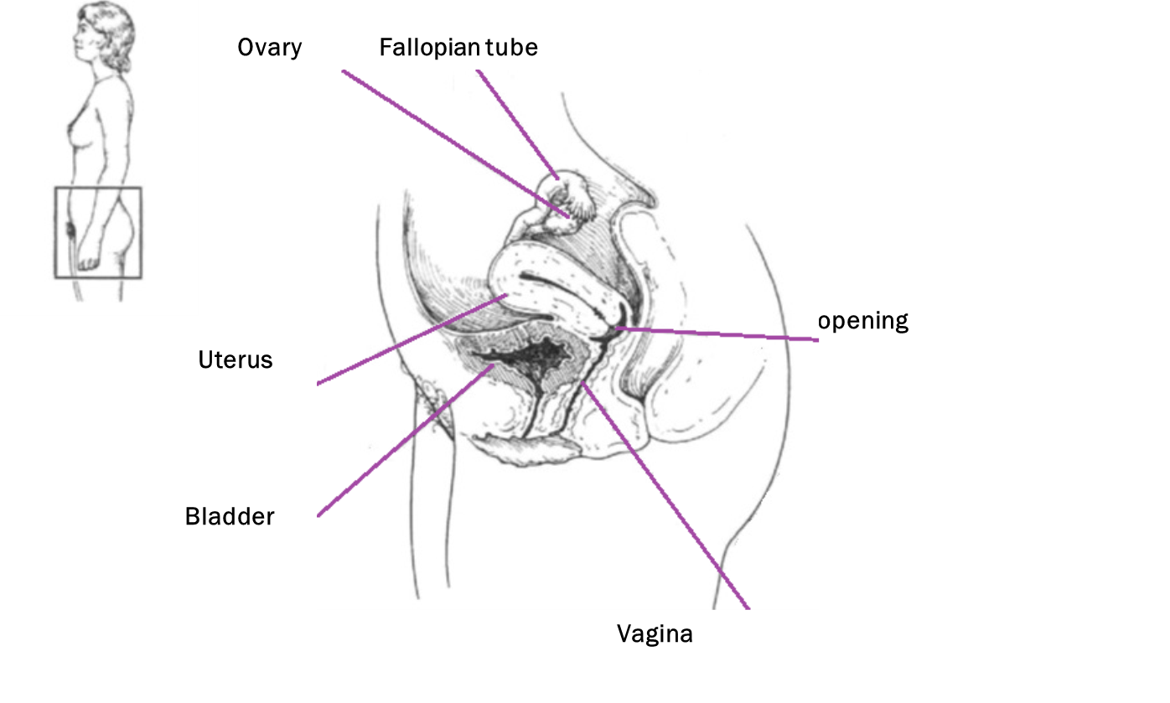
Internal female reproductive organs

Slide 21
Before opening FC2

Slide 22
FC2 insertion (1)

Slide 23
FC2 insertion (2)

Slide 24
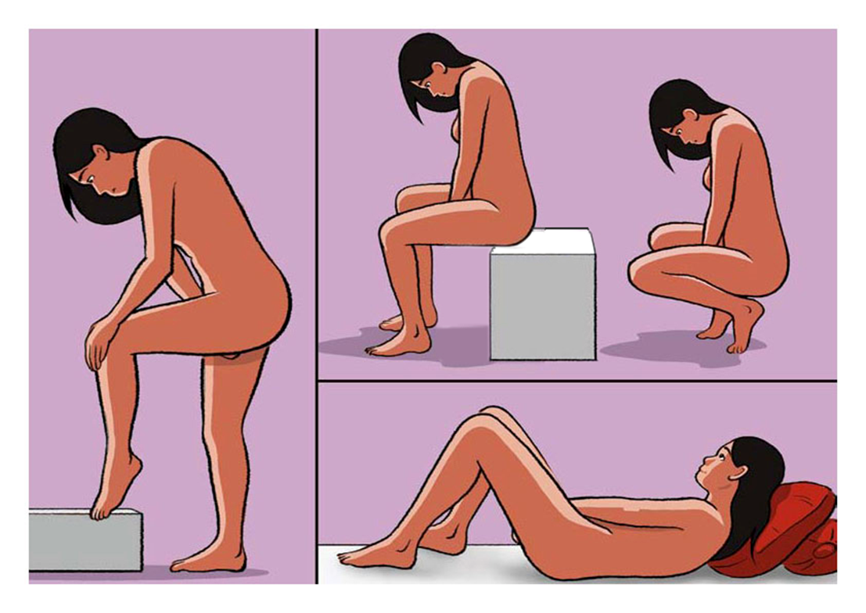
FC2 insertion (3)

Slide 25
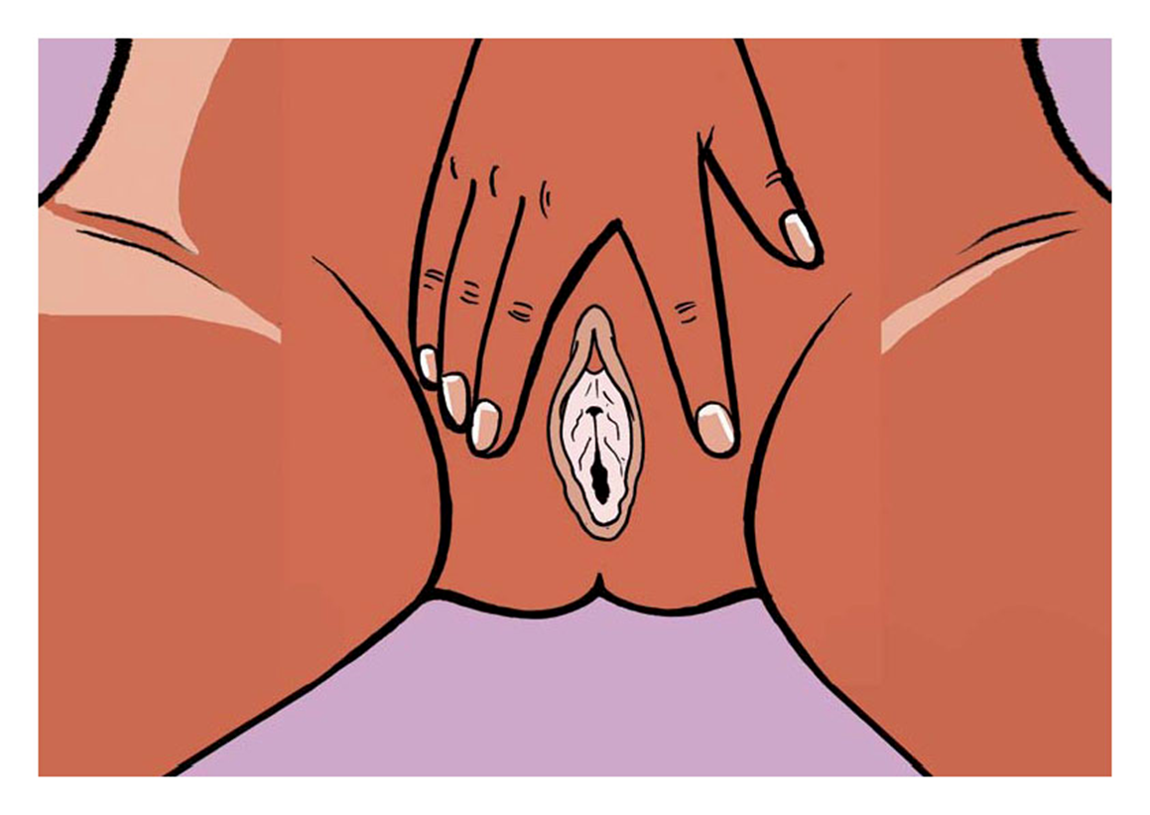
FC2 insertion (4)

Slide 26


FC2 insertion (5)

Slide 27
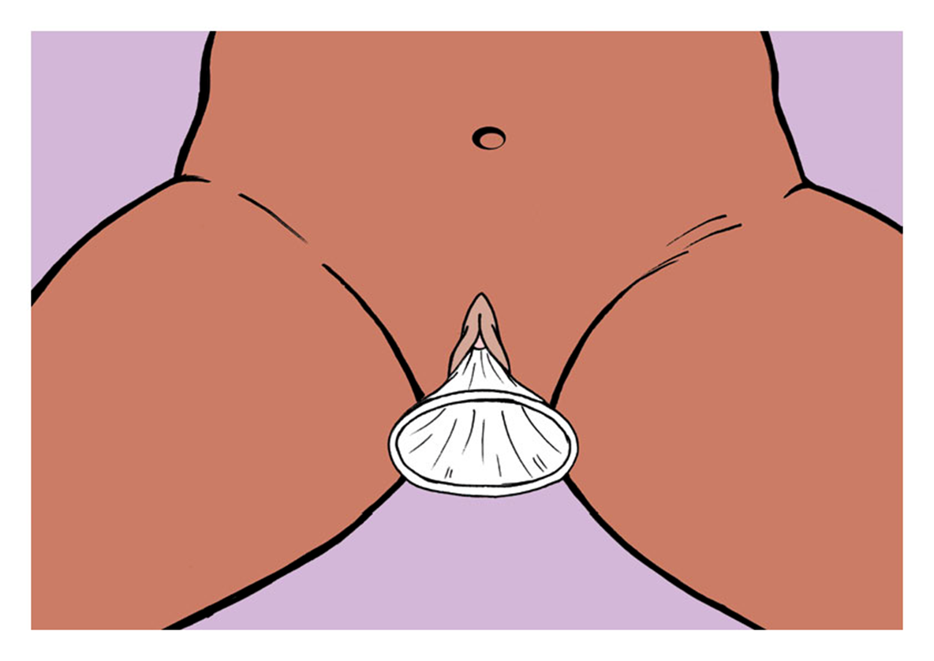
FC2 insertion (6)

Slide 28
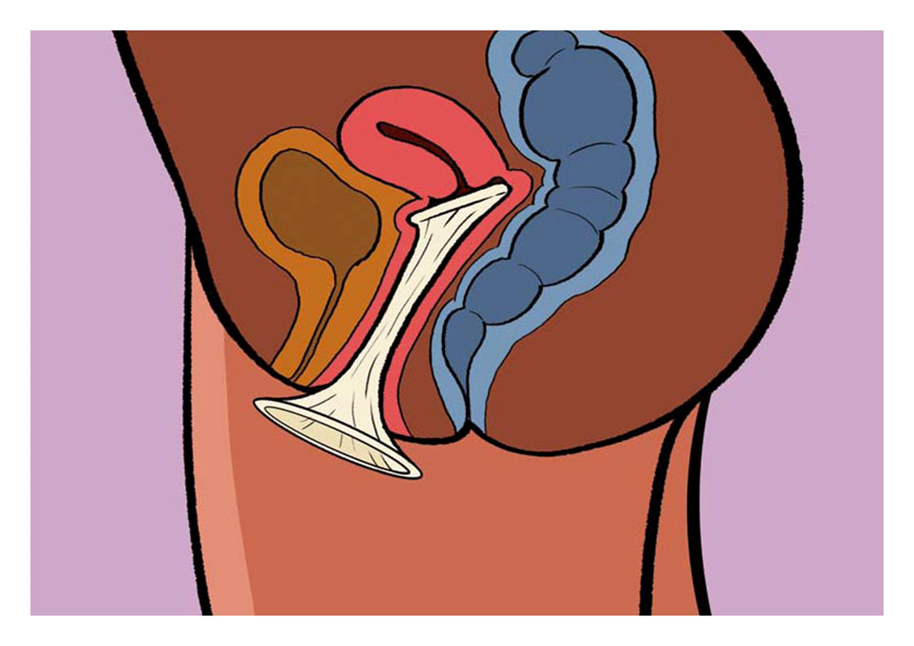
FC2 insertion (7)

Slide 29
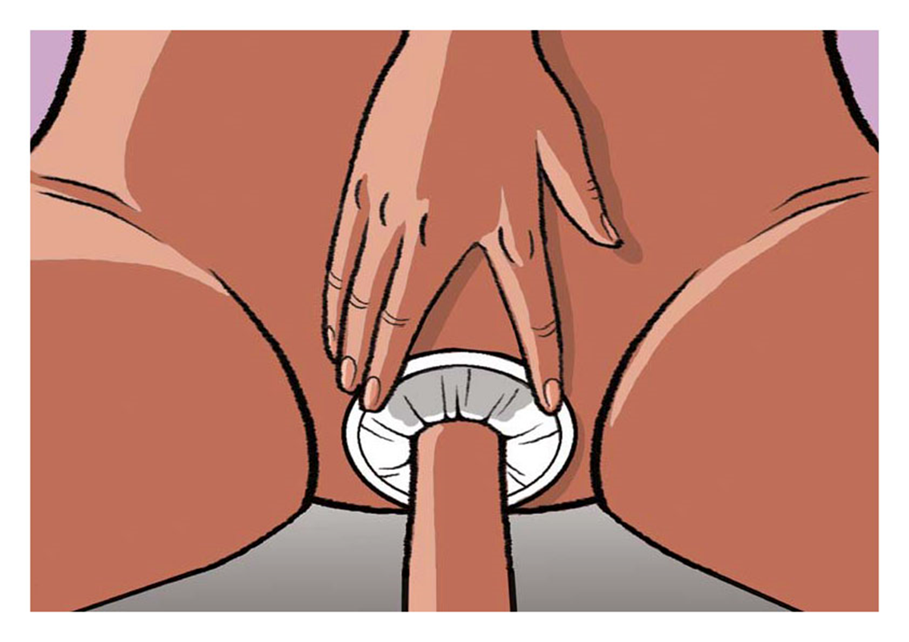
FC2 use during sex

Slide 30
FC2 after use

Slide 31
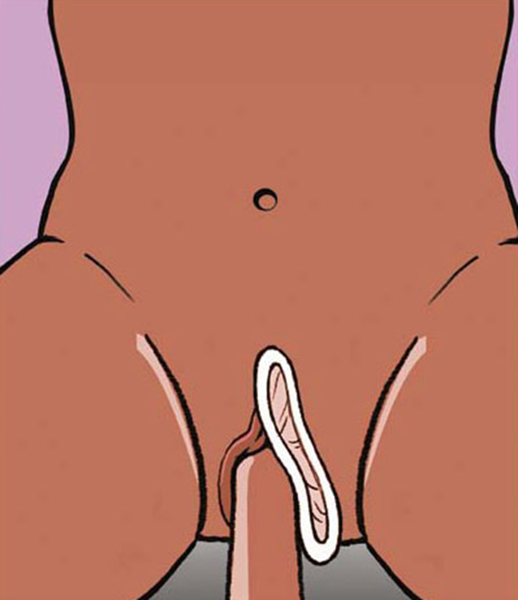
FC2 failure problems (1)

Slide 32
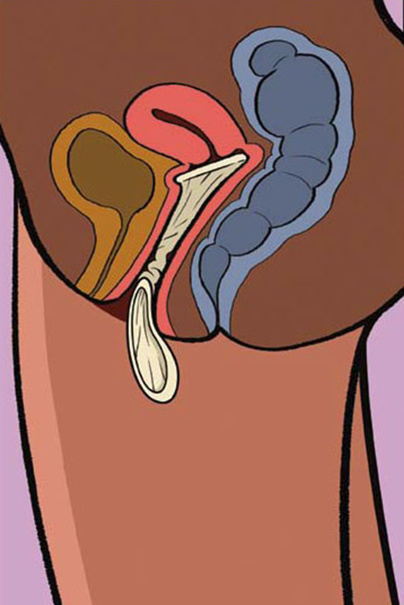
FC2 failure problems (2)

Slide 33
Learning objectives Module 4
Talking with clients
By the end of this module participants will be able to:
Summarize FC2 promotional messages.
Review lessons learned during the workshop.

Slide 34
Thank you for your attention and participation!

